Slide 1

McGraw-Hill Technology Education
Copyright © 2006 by The McGraw-Hill Companies, Inc. All rights reserved.

Slide 2
Chapter 10A
Connecting to the Internet

Slide 3
Wired Internet Connections
Dial-up connections
  Standard phone lines and a modem
  Computer dials a number for your ISP
  All Internet programs use the connection
  Applications might need configured

Slide 4
Wired Internet Connections
High-speed broadband connections
  Any connection faster than dialup
  Networks share the broadband connection
    All users access the same connection
    T or DSL lines common
  Home use increasing due to
    Lower cost
    Increased availability

Slide 5
Wired Internet Connections
ISDN
  Offers speeds up to 1.5 Mbps
  Uses standard phone lines
  Requires special equipment
  Simultaneous use of phone and data
Notes:
Teaching tip
More information on ISDN can be found on webopedia.com/TERM/I/ISDN.html.

Slide 6
Wired Internet Connections
DSL
  Offers speeds up to 30 Mbps
  Uses modified phone lines
    Needs special DSL modem
  Simultaneous use of phone and data
  Asynchronous DSL
    Different up and download speeds
  Synchronous DSL
  Variable DSL
    Speed changes based on traffic
Notes:
Teaching tip
For more information on dsl see www.dslreports.com.

Slide 7
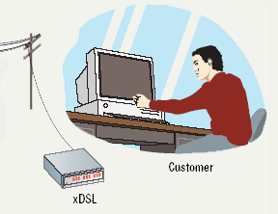
DSL Connections

Slide 8

Wired Internet Connections
Cable modems
  Speeds up to 3 Mbps
  Uses cable TV wires
  Requires a cable modem
  Simultaneous use of TV and data

Slide 9
Software Accessing The Internet
Application programming interface (API)
  Simplifies connection to network devices
  Allows any application to access Internet
  UNIX API uses sockets
  Windows API uses winsock
Notes:
Insider information
A socket (UNIX or Windows) is a combination of an IP address and a port. For example, connecting to the HTTPS port on machine 192.168.110.15. The socket is 192.168.110.15:443.

Slide 10
Software Accessing The Internet
Network drivers
  Control access to the hardware
  Ethernet and dial-up require a driver
  API connects to the driver
Notes:
Teaching tip
Figure 10A.4 on page 387 describes this interaction very well.

Slide 11
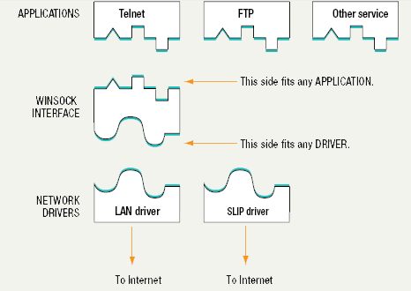
API and Drivers

Slide 12
Wireless Internet Connection
Wireless WAN (WWAN)
  Wireless network over a large area
  Uses radio signals to transfer data
  Speeds range from 1 to 100 Mbps
  Antennas required
  Subject to atmospheric disturbances
Notes:
Teaching tip
Grok Technologies of Pittsburgh PA provides a good example of WWAN plans. Visit www.groktechnologies.com for more information.

Slide 13
Wireless Internet Connection
Satellite services
  Internet access in remote regions
  Suitable for home and office use
  Needs a VSAT at the client
    Very Small Aperture Terminal
    Connects to the satellite
  Modem connects to the VSAT
Notes:
Teaching tip
Satellite services are not inexpensive. Www.groundcontrol.com is one site offering satellite Internet services.

Slide 14
Wireless Internet Connection
Wireless LANs (WLAN)
  Network without wires
  Connects to a broadband LAN connection
  WAP are wired directly into the LAN
  Nodes use wireless

Slide 15
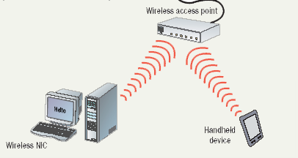
Wireless LAN

Slide 16
Wireless Internet Connection
Wireless security
  Crucial to protect wireless transmissions
  Encryption protects transmissions
  Wireless Encryption Protocol is quite weak
  Wi-Fi Protected Access is stronger
  MAC address of trusted computers
  War driving

Slide 17
Chapter 10A
End of Chapter

